Slide 1

Exploratory Data Analysis and Prediction on Residential Building
AMS6001 Group Project (Group 1)
Tsang Hei Man
LIU Tong
TIAN Donghao
XIAO Xin
HE Xiaoxiao
Nov 23, 2023

Slide 2

Agenda
Background & GOAL
Dataset Overview
Exploratory Data Analysis
Liner Regression
LASSO
Support Vector Machine
Diagnostics
Conclusion

Slide 3
Background
• What?
– Residential buildings
• Where?
– Tehran, Iran
• When?
– From 1972 to 1990
• Source
– Machine Learning Repository hosted by
University of California, Irvine
GOAL
- To explore the dataset through data analysis to identify attributes strongly associated with Actual sales prices and Actual construction costs.
- To develop a predictive model using statistical modeling techniques to explain the data as accurate as possible.

Slide 4
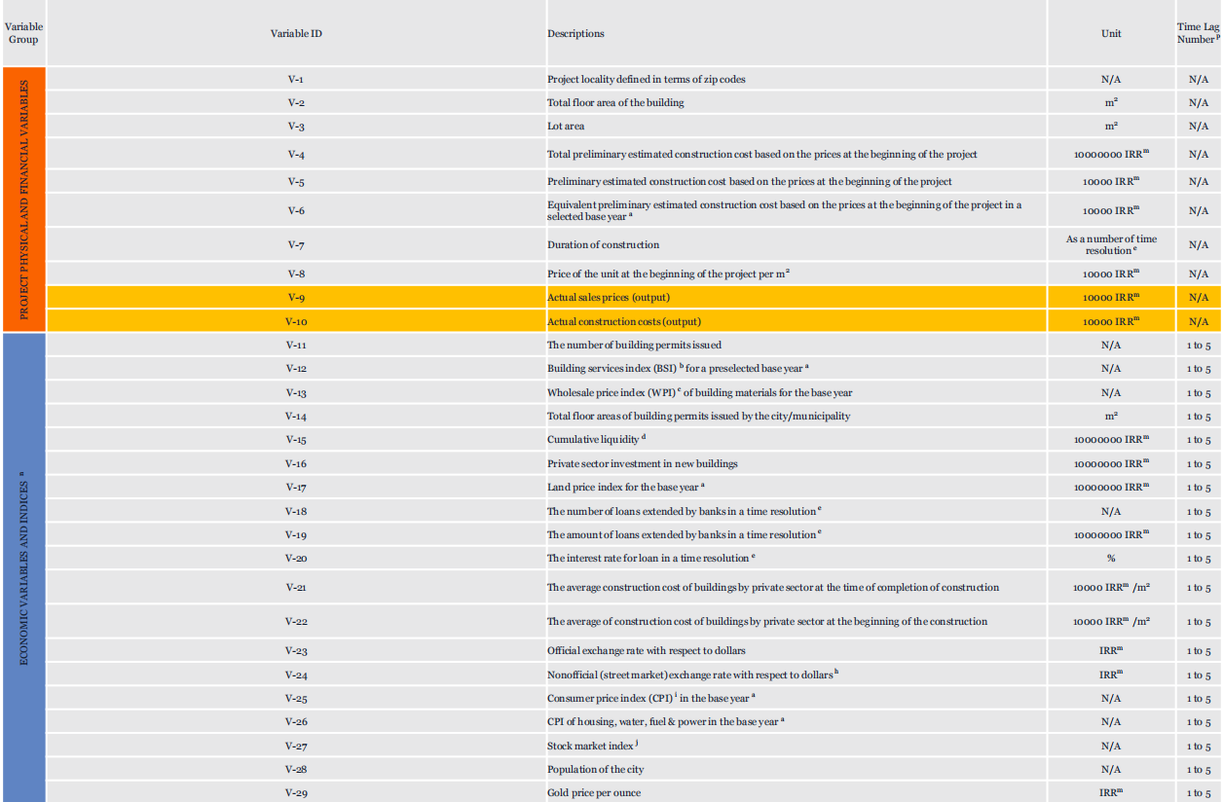
Dataset Overview

Slide 5
Data Preprocessing

Slide 6
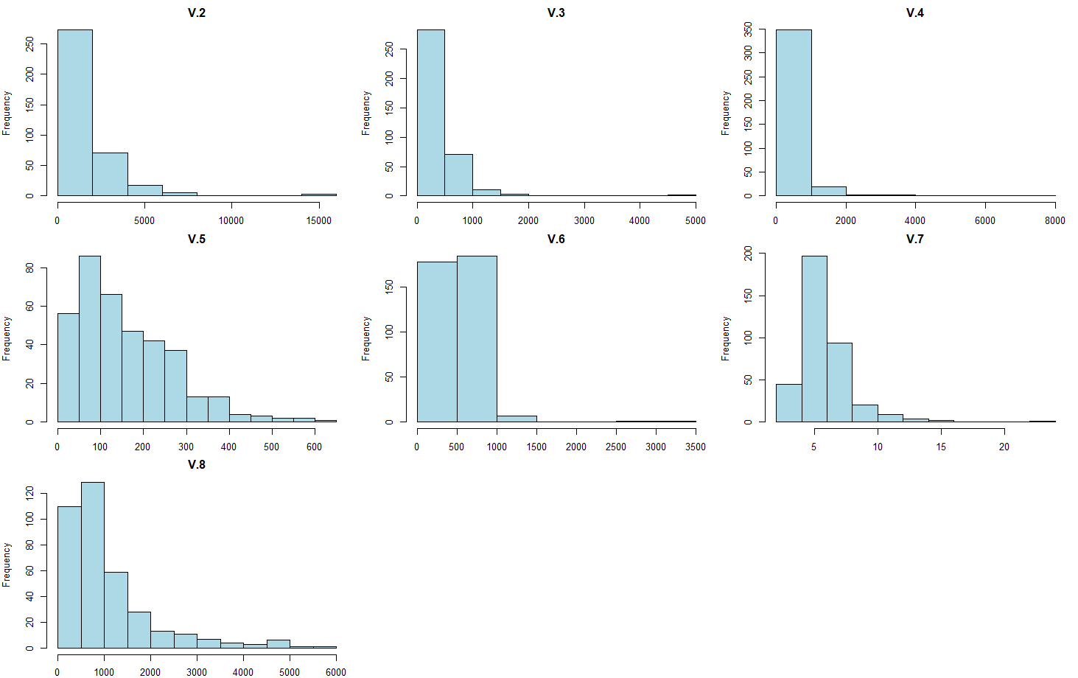
Exploratory Data Analysis
Distribution of Variables V2 – V8

Slide 7
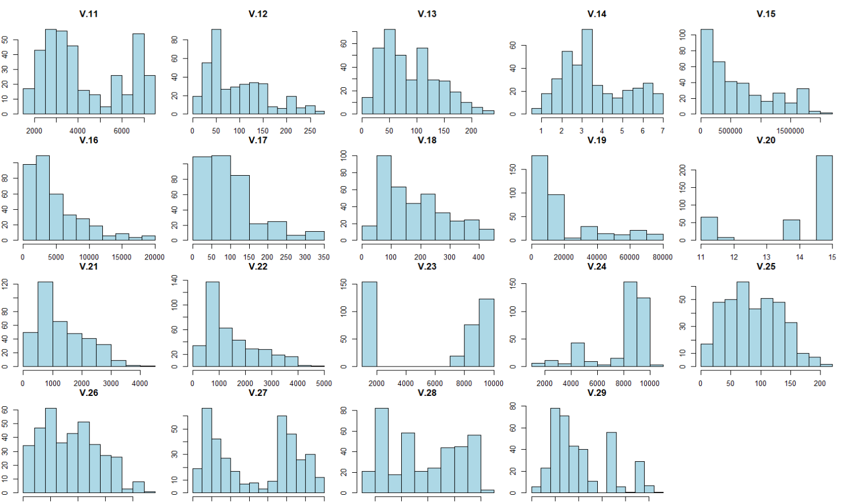
Exploratory Data Analysis
Distribution of Variables V11 – V29

Slide 8
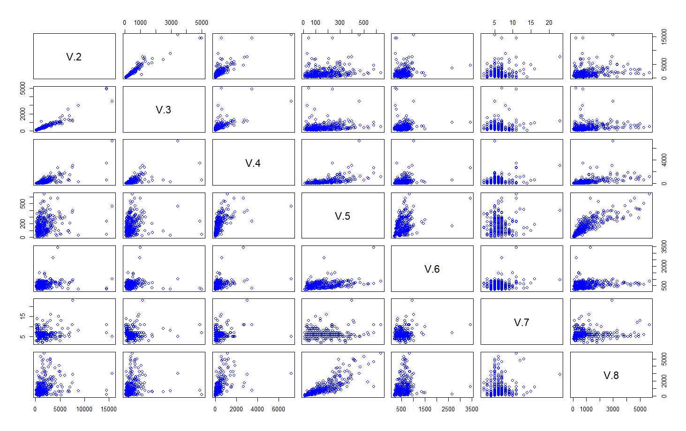
Exploratory Data Analysis Bivariate Analysis of Numeric Variables
Correlation between V2 – V8 variables
Notes:
There are no strong correlation between numerical attributes

Slide 9
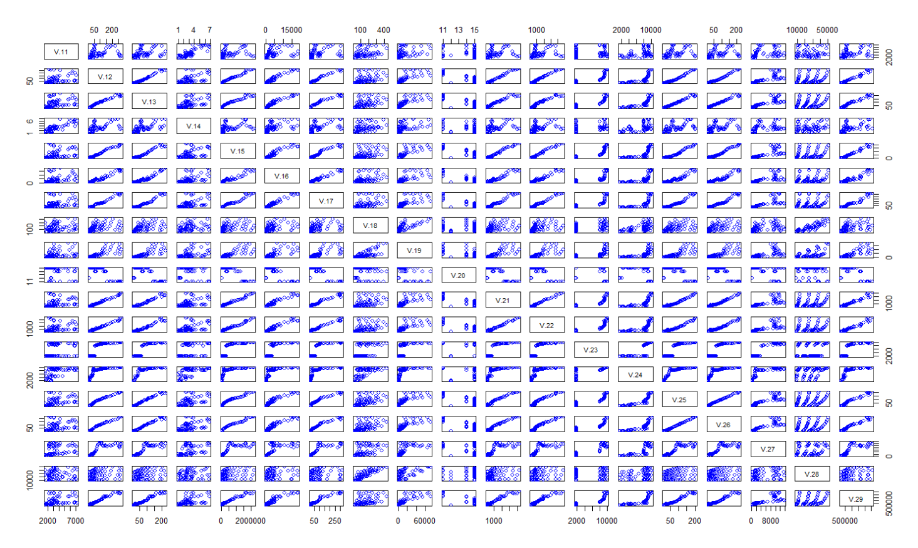
Exploratory Data Analysis Bivariate Analysis of Numeric Variables
Correlation between V11 – V29 variables

Slide 10
Modeling Techniques (1) Methodology
Algorithms | # Predictors | Other Details | Cross-Validation
Simple Linear Regression | V2-v29 (one lag)
LASSO | V2-V29( 5 lag & avg) | cv.glmnet(x,y,alpha=1,nfolds = 10) | 10 folds
SVM | V2-v29 | method = “svmLinear” | 10 folds
PCA | V2-v29 (all lag&avg) | pcr(V.9~.,data=data,scale=TRUE,validation="CV")
 |  |  | -
Notes:
Choose a Suitable Algorithm: Select an appropriate data mining algorithm based on the problem at hand, the characteristics of the dataset, and your goals. Some algorithms that can handle mixed attribute types include decision trees, random forests, Naive Bayes classifiers, and ensemble methods like Gradient Boosting and AdaBoost.
Train the Model: Split the dataset into training and testing sets. Use the training set to train the chosen model on the data.
Evaluate the Model: Use the testing set to evaluate the performance of the trained model. Calculate appropriate evaluation metrics such as accuracy, precision, recall, F1-score, or area under the ROC curve (AUC-ROC) based on the problem type.

Slide 11
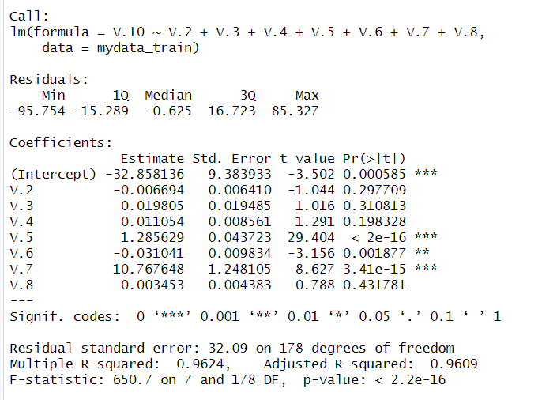
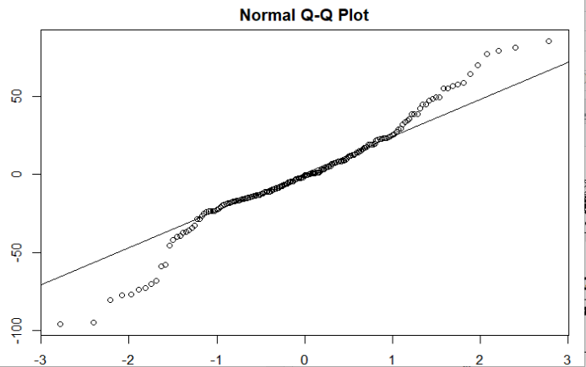
Linear Regression
Small model
Build a linear model of main predictors V2 – V8
Summary and polt the result
Rmse 38.5362

Slide 12
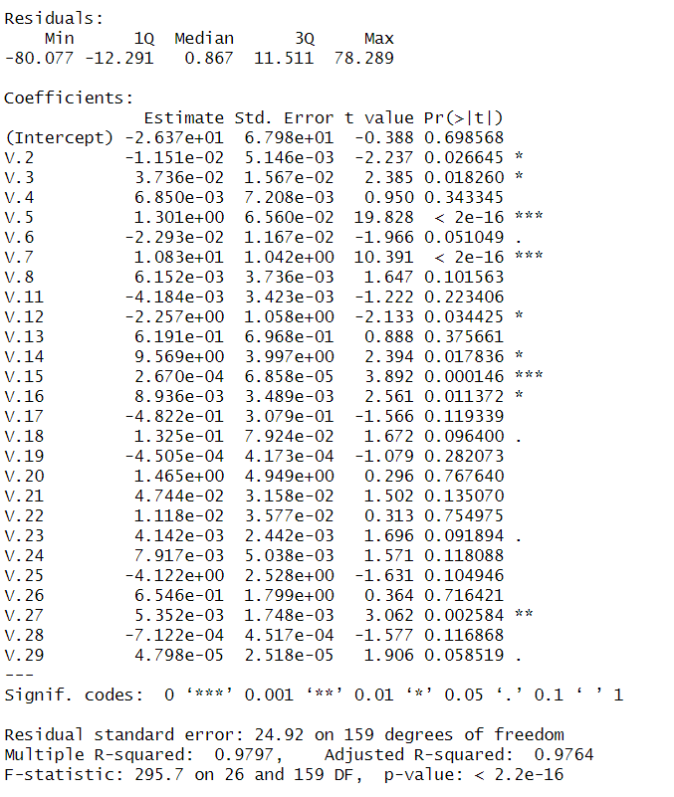
Linear Regression
Build a linear model of main predictors V2 – V29 (pick the first lag)
Summary the result
Big model or small model?
Rmse8 : 38.5362
Rmse29 :37.6944

Slide 13
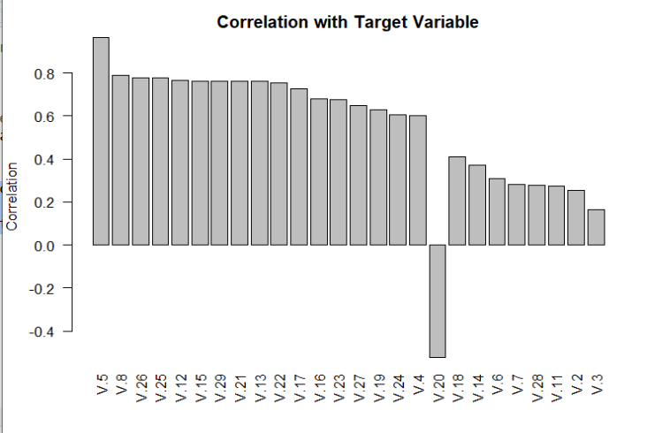
Variables selection Correlation with Target Variable
Correlation from 26 variables that exceeds threshold (0.2):
Notes:
There are no strong correlation between numerical attributes nor with the output.

Slide 14
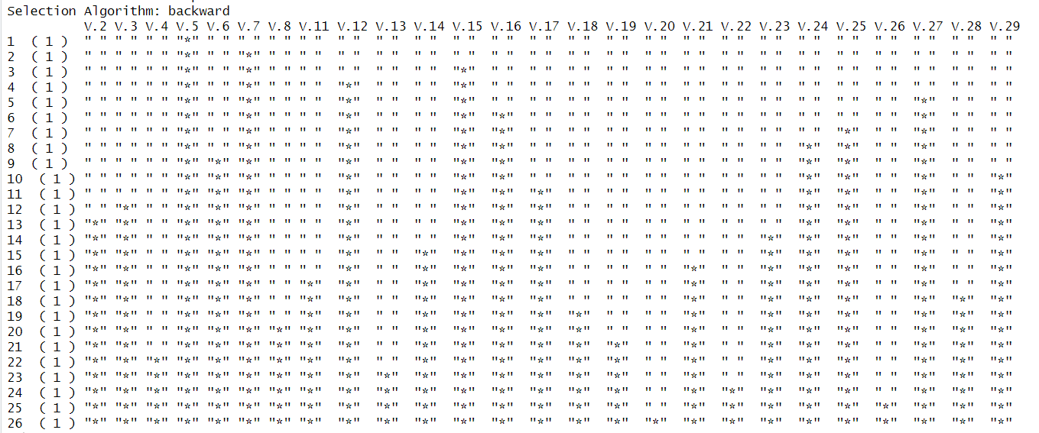
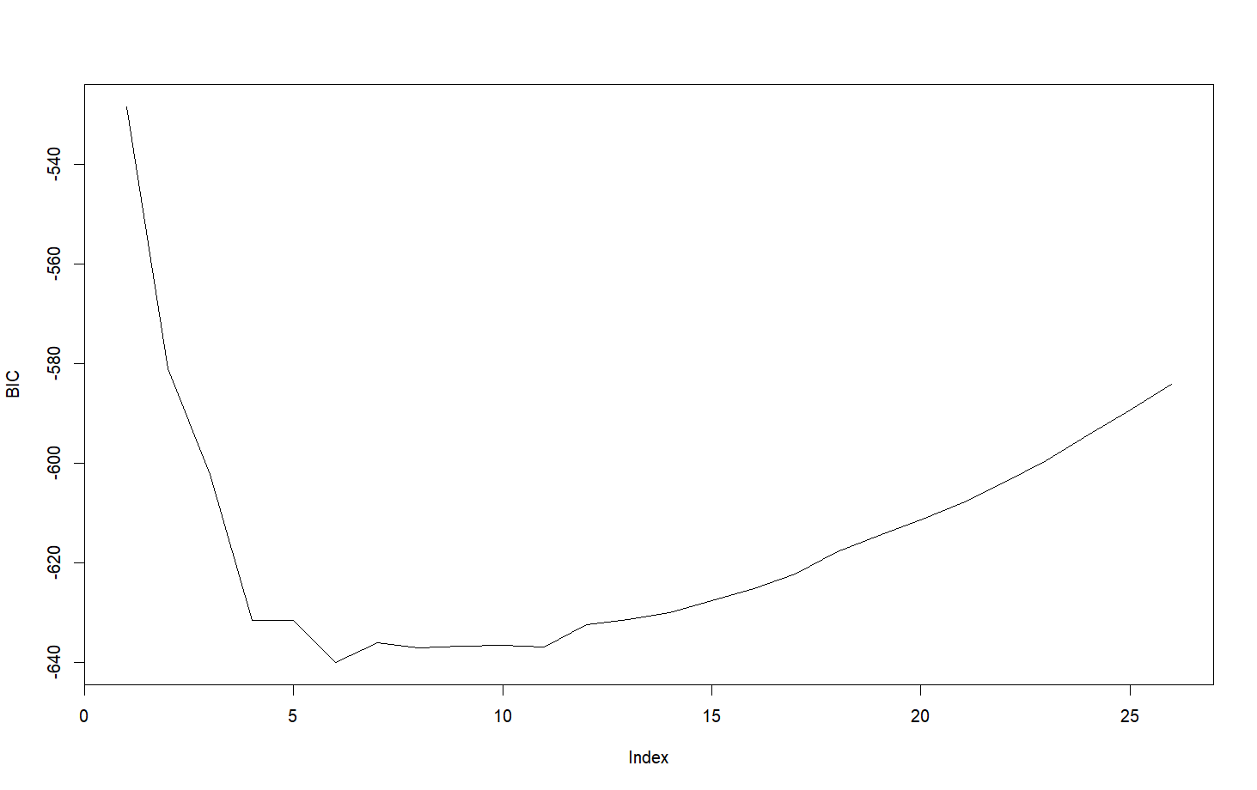
Subset selection (Backward/BIC)
Backward selection to find the best subset
BIC plot to find the proper size of subset
BIC vs. Subset Size
Subset of 10 includes factorized variables, which only belong to 6 distinct variables.
Subset of 6 variables selected: (sex, cp, trtbps, slp, caa, thall)

Slide 15
Subset selection (Forward/BIC)

Slide 16
Variables selection Summary
Correlation between numerical variables are not strong;
There is no clear distinction among the numerical variables with respect to the target;
Correlation between predictors and target variable suggests a subset of 6 variables:
Backward subset selection suggests that a subset of 6 could be proper:
We will also try to build models with all predictors and see their effect.
Notes:
There are no strong correlation between numerical attributes nor with the output.

Slide 17


LASSO
Dimension reduction techniques for large p (V2 –V29) problems

Slide 22
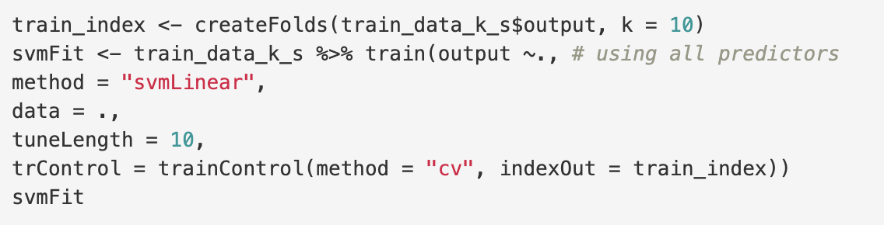
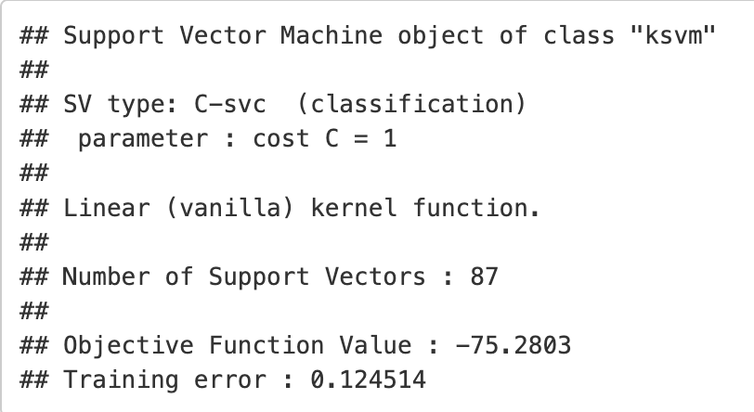
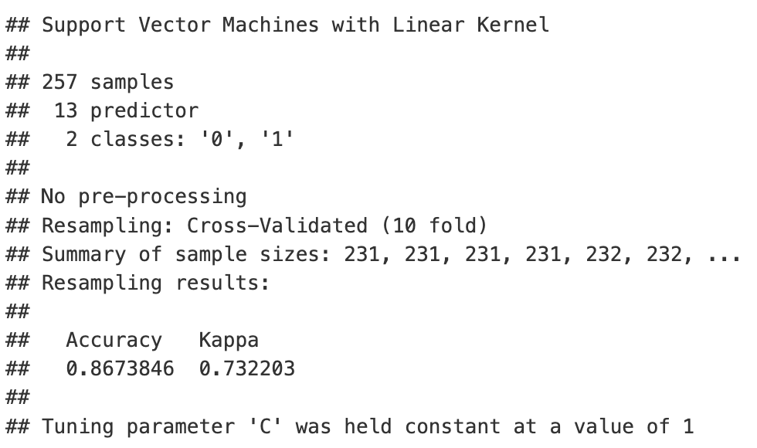
SVM
Modeling Techniques (2) Model Training
(1) Model with all predictors (SVM)
Accuracy Kappa
0.86738 0.73220
Notes:
Train the Model: Split the dataset into training and testing sets. Use the training set to train the chosen model on the data.

Slide 23
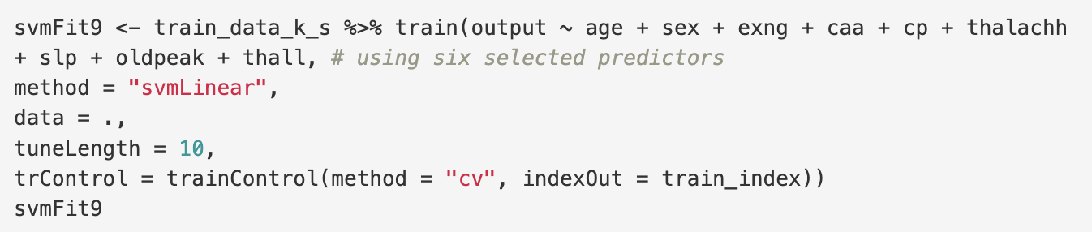
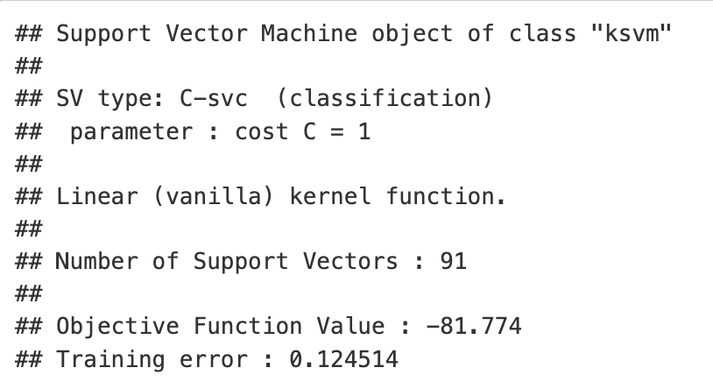
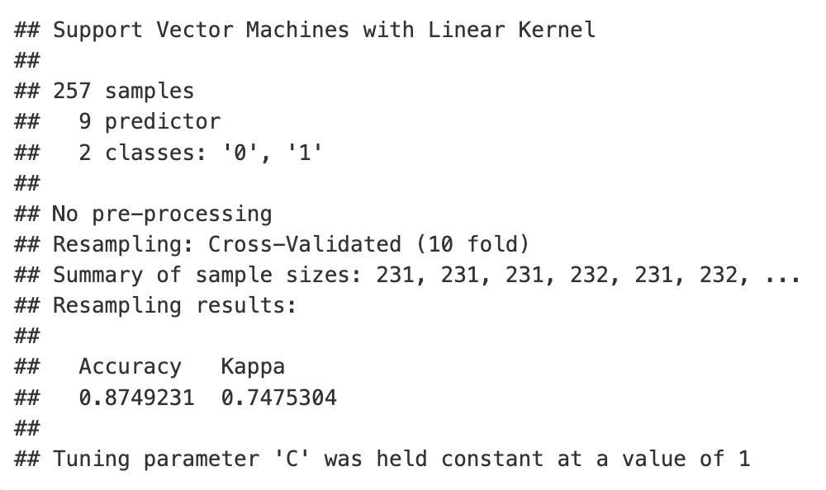
SVM
Modeling Techniques (2) Model Training
(2) Model with nine predictors (SVM9)
Accuracy Kappa
0.87492 0.74753
Notes:
Train the Model: Split the dataset into training and testing sets. Use the training set to train the chosen model on the data.

Slide 24
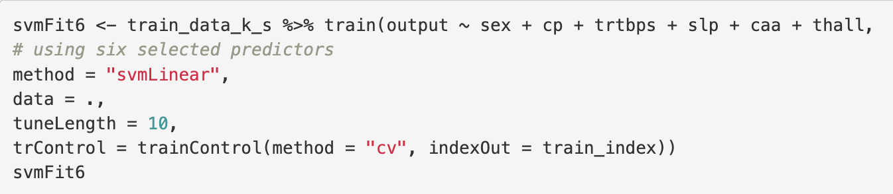
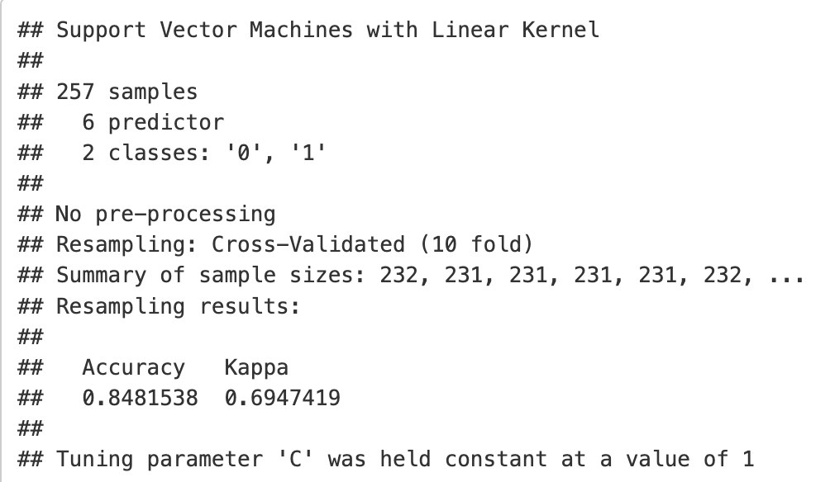
SVM
Modeling Techniques (2) Model Training
(3) Model with six predictors (SVM6)
Accuracy Kappa
0.84815 0.69474
Notes:
Train the Model: Split the dataset into training and testing sets. Use the training set to train the chosen model on the data.

Slide 25
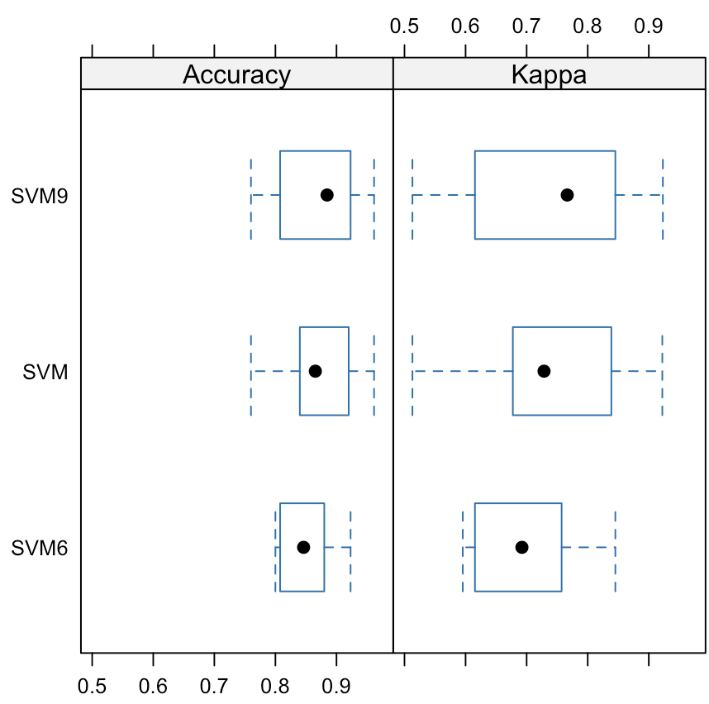
SVM
Modeling Techniques (3) Model Evaluation
Comparison of three SVM models:
Model | Accuracy | Kappa
SVM | 0.86738 | 0.73220
SVM9 | 0.87492 | 0.74753
SVM6 | 0.84815 | 0.69474
Notes:
Train the Model: Split the dataset into training and testing sets. Use the training set to train the chosen model on the data.

Slide 26
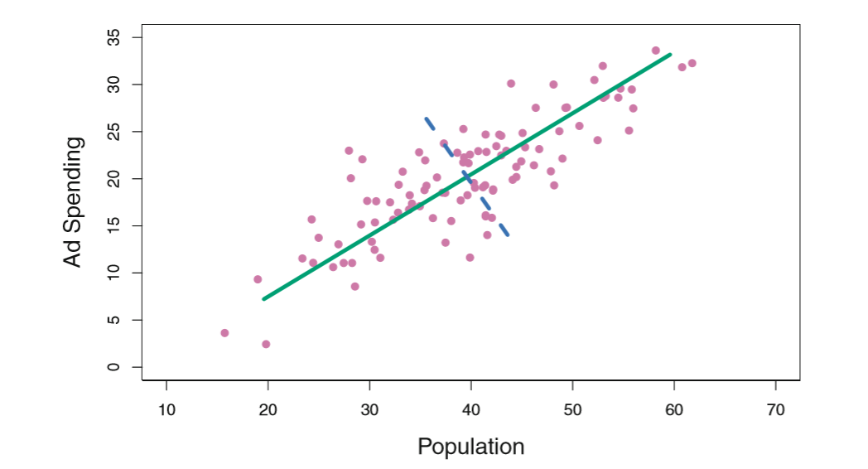
Principal Component Analysis
For large p cases, it is impossible to input all predictors into the regression model.
The goal of PCA is to find a new set of attributes
[called principal components (PCs), which are linear
combinations of the original attributes] that better
captures the variability of the data.

Slide 27
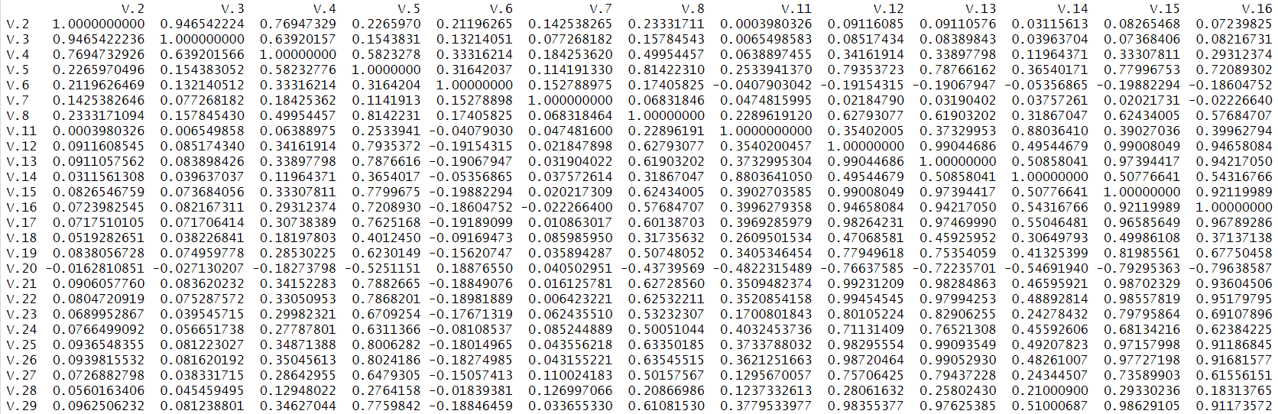
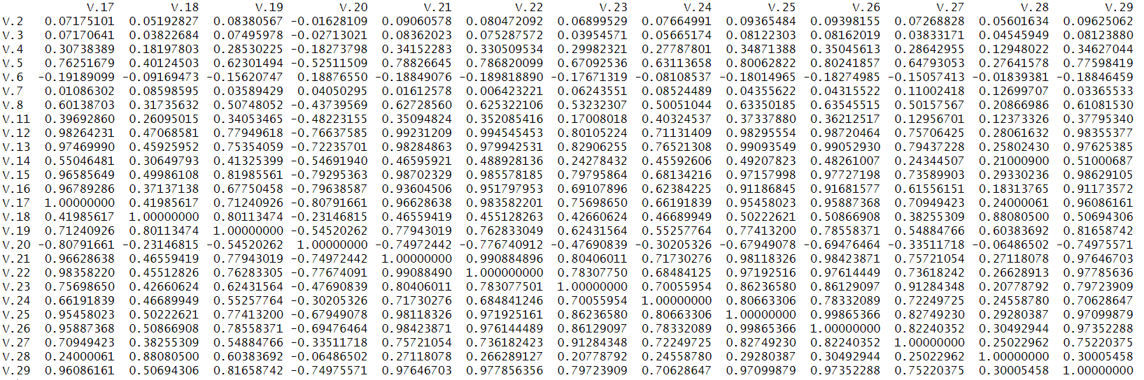
PCA
The correlation matrix

Slide 28
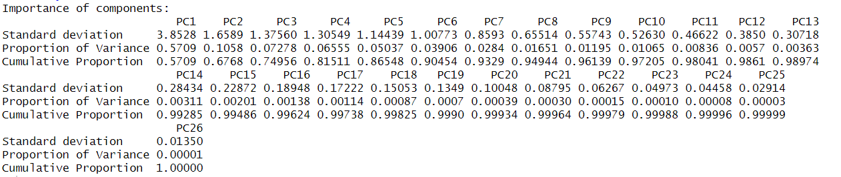
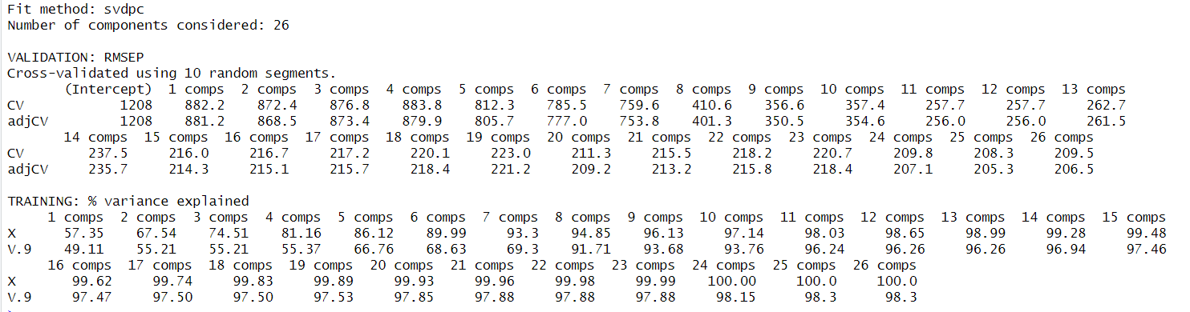
PCA

Slide 29
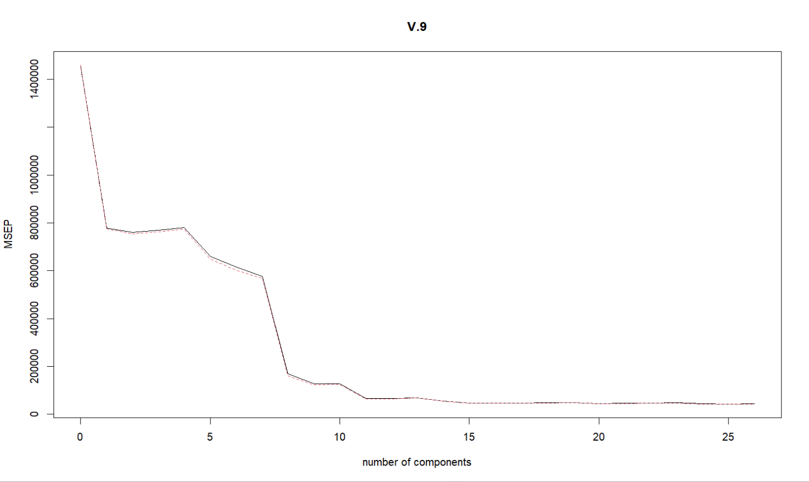
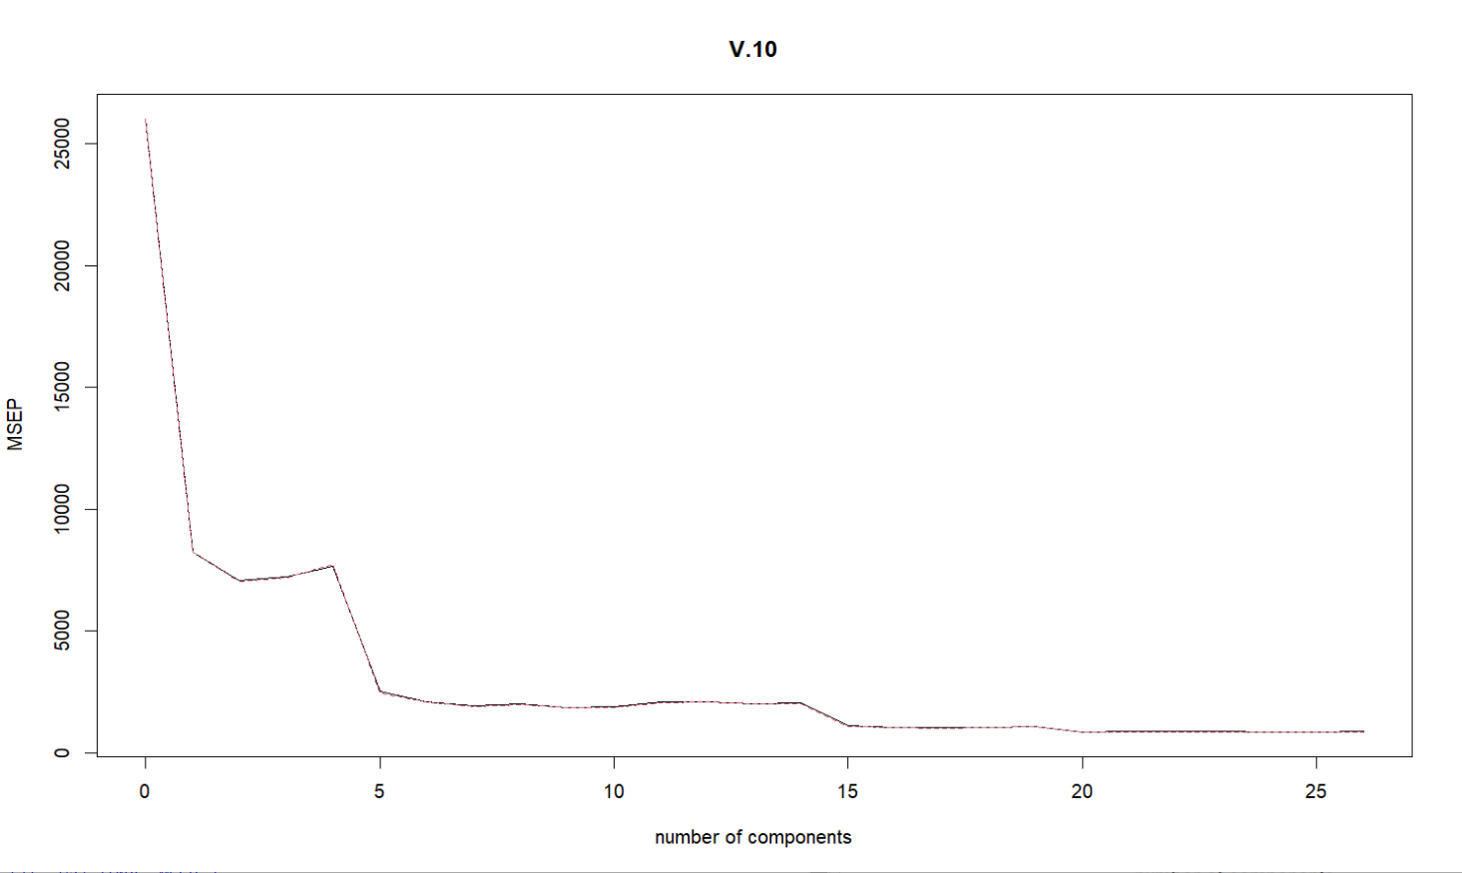
PCA
V9(Actual sales prices)
RMSE 193.4545
V10(Actual construction costs)
RMSE 40.8531

Slide 30
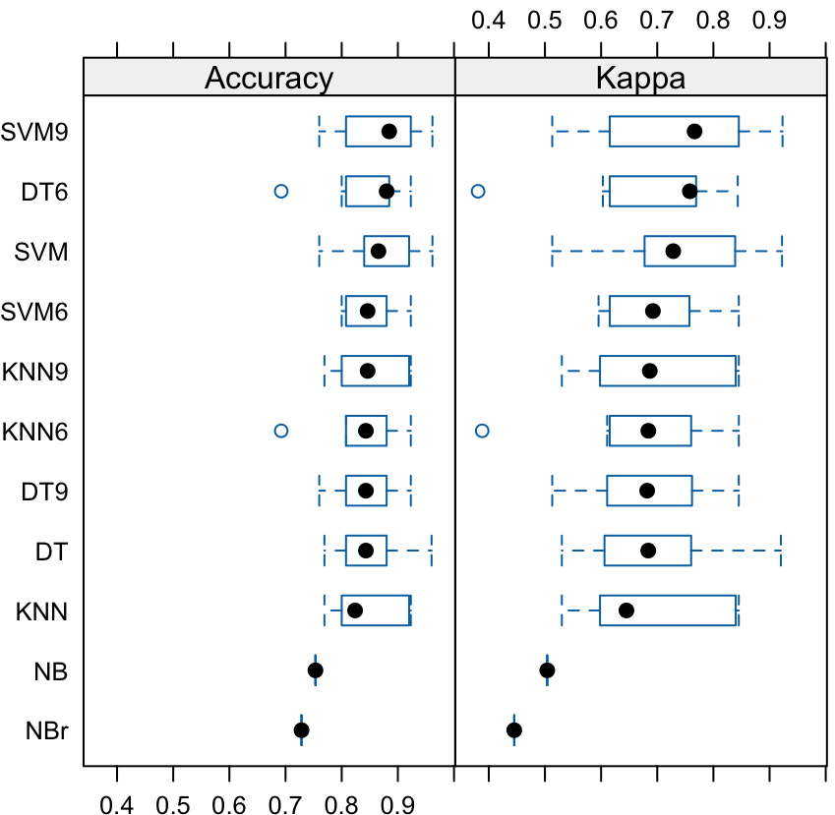
Model Comparison
Among the classifiers, SVM using 9 selected features work best;
On the other hand, Logistics Regression using 6 selected features also work well.
We put them both to Test Data to decide which is our FINAL SELECTED MODEL.
Notes:
Compare the performance of different models based on the evaluation metrics. Consider both the overall performance and the specific requirements of your problem. For example, if interpretability is important, you may prefer a simpler model even if its performance is slightly lower.
Based on the performance comparison, select one or a few models that exhibit better performance on the evaluation metrics and align with your goals and requirements. These models are considered promising candidates.

Slide 31
Notes:
Take the selected promising models and validate them using a separate validation dataset or cross-validation. This step helps to assess the final model's generalization performance and ensure that it performs well on unseen data.

Slide 32
Conclusion

Slide 33
Thank you
Q & A

Slide 34
Appendix I: Dataset description
Source: https://www.kaggle.com/datasets/rashikrahmanpritom/heart-attack-analysis-prediction-dataset/data

Slide 35
Appendix II: R Packages & Codes

Slide 36
References
Rafiei, M.H. and Adeli, H. (2015). A Novel Machine Learning Model for
Estimation of Sale Prices of Real Estate Units. ASCE, Journal of
Construction Engineering & Management, 142(2), 04015066
Journal of Property Research（2020） Predicting property prices with machine learning algorithms Winky K.O. Ho , Bo-Sin Tang & Siu Wai Wong
Notes:
1. https://www.ajconline.org/article/0002-9149(89)90524-9/pdf
Abstract
A new discriminant function model for estimating probabilities of angiographic coronary disease was tested for reliability and clinical utility in 3 patient test groups. This model, derived from the clinical and noninvasive test results of 303 patients under-going angiography at the Cleveland Clink in Cleveland, Ohio, was applied to a group of 425 patients undergoing angiography at the Hungarian Institute of Cardiology in Budapest, Hungary (disease prevalence 38%); 200 patients undergoing angiography at the Veterans Administration Medical Center in Long Beach, California (disease prevalence 75%); and 143 such patients from the University Hospitals in Zurich and Basel, Switzerland (disease prevalence 84%). The probabilities that resulted from the application of the Cleveland algorithm were compared with those derived by applying a Bayesian algorithm derived from published medical studies called CADENZA to the same 3 patient test groups. Both algorithms overpredicted the probability of disease at the Hungarian and American centers. Overprediction was more pronounced with the use of CADENZA (average overestimation 16 vs 10% and 11 vs 5%, p < 0.001). In the Swiss group, the discriminant function underestimated (by 7%) and CADENZA slightly overestimated (by 2%) disease probability. Clinical utility, assessed as the percentage of patients correctly classified, was modestly superior for the new discriminant function as compared with CADENZA in the Hungarian group and similar in the American and Swiss groups. It was concluded that coronary disease probabilities derived from discriminant functions are reliable and clinically useful when applied to patients with chest pain syndromes and intermediate disease prevalence.

